Slide 1

CHARTING A COURSE FOR MWANGAZA FILM STUDIO
Analysis & Recommendations for Maximizing Financial Success
Group 5 | Edwin Kiprop

Slide 2
Overview of the Strategy
Objective: To optimize movie production decisions based on genre, runtime, and budget analysis.
Goal: Maximize profitability by aligning film development strategies with data insights.
Briefly outline the upcoming slides: data analysis, key insights, and recommendations.

Slide 3
Understanding the Business Challenge and Key Data Insights
Problem: How to make informed, data-driven decisions about movie genres, runtime, and budgets for higher financial success.
Key Objective: Use data insights to guide movie development strategies that maximize audience appeal and financial performance
Overview of the data sources and methods used to derive insights (without going too technical).
Mention the genres, runtimes, and financial success metrics analyzed to form the strategy.

Slide 4
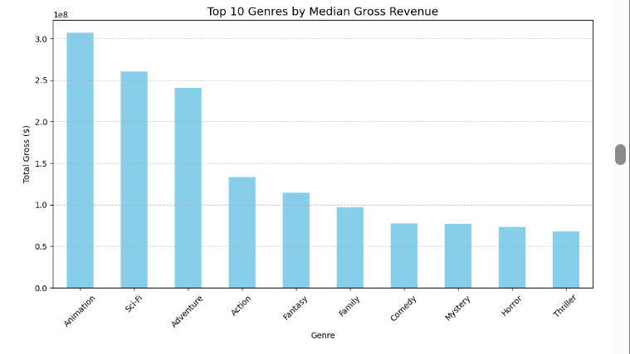
Genre vs. Revenue
Animation-Sci-Fi hybrids outperform other genres in terms of revenue
.
Insight: Focus 60% of the development budget on these genres.

Slide 5
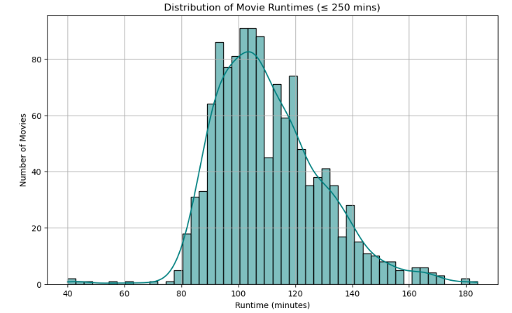
Runtime vs. Revenue
Films with runtimes of 105-110 minutes tend to perform better.
Insight: Aim for a runtime of 105-110 minutes for optimal audience reception and financial success.

Slide 6
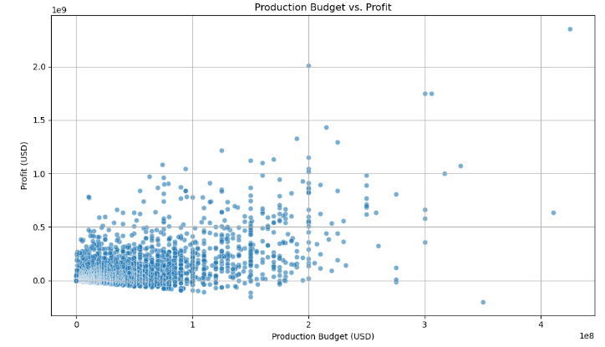
Budget vs. Profitability
High-budget films in blockbuster genres generally show high returns.

Slide 8
Data-Driven Recommendations for Movie Production
Genre Strategy Recommendation:
Focus production on Animation-Sci-Fi hybrids, allocating 60% of the development budget to these genres. Use Adventure elements to broaden appeal.
Runtime Optimization:
Target a runtime of 105-110 minutes for optimal audience engagement and revenue.
Budget Strategy:
Prioritize investment in high-budget films within proven blockbuster genres like Action, Adventure, and Sci-Fi.

Slide 9
Next Steps for Implementation
Review the insights with key stakeholders and adjust the film production portfolio accordingly.
Conduct market research and audience testing for the targeted genres and runtime.
Finalize budgets and start pre-production on films within the recommended genres.

Slide 10
Thank You
Feel free to ask any questions.
🔹 Name: Edwin Kiprop Chelimo 🔹 LinkedIn Profile: [https://www.linkedin.com/edwin-chelimo-96156334a/]

